Slide 1
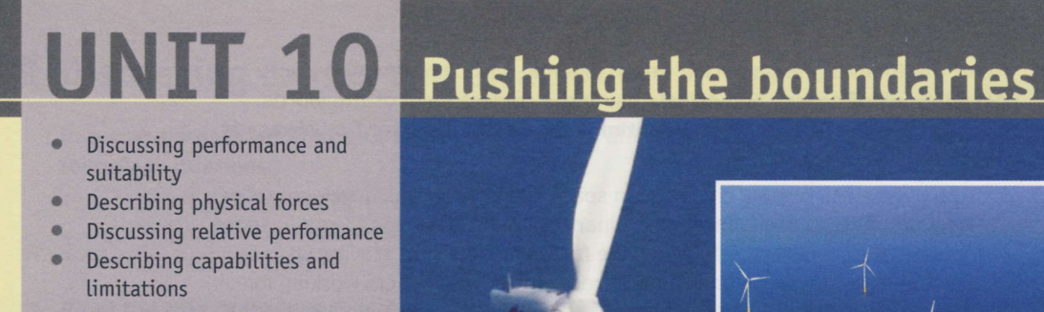
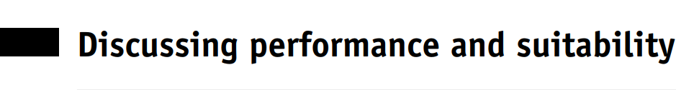
Notes:
Discussing performance and suitability (pages 78 and 79) This section is based on the fact that, in order to find solutions to technical problems/ requirements, choices need to be made. This might involve choosing the most appropriate materials for making products, choosing among standard components available from different suppliers, choosing the most efficient assembly/manufacturing procedure, etc. The communication surrounding choices of this type centres on issues such as appropriateness/suitability, effectiveness, efficiency, reliability, etc. The language used to discuss these issues is therefore the focus of this section.
vocabulary useful in this section. adequate/inadequate, appropriate/inappropriate, consistent/inconsistent, economical/uneconomical, effective/ineffective, cost-effective, efficient/inefficient, reliable/unreliable, sufficient/insufficient,

Slide 2
Before you begin …
Explain what is meant by pushing the boundaries (= trying to do things that have never been done before).
Give examples of engineering projects that have pushed the boundaries.
Explain what is meant by performance (= how well something performs) and suitability (= how suitable something is for the job).
Explain that to explore questions of performance and suitability this section looks at the design of wind turbines.

Slide 3
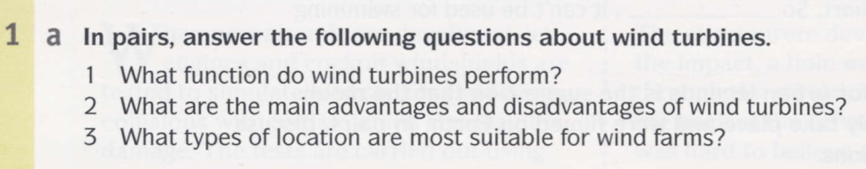
They use the kinetic energy, movement of the wind, to generate electricity.
Advantage: They use a renewable, non-polluting energy source that is readily available. Disadvantages: The wind is not constant, so wind turbines cannot function all the time. They also have a major visual impact due to their height and size, and are relatively noisy.
Locations exposed to the wind, such as high ground, flat areas and coastal areas

Slide 4
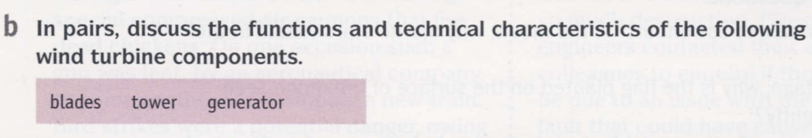
The blades turn due to the airflow generated by the wind. To function, they need to have a specially designed aerodynamic profile. They must also be stiff, to avoid flexing and consequently hitting the tower, and relatively light to allow them to turn easily.
The tower must be rigid, to resist the bending force generated by the pressure of the wind. It must also have a relatively narrow profile, to minimise the aerodynamic effect it has on the blades. When a blade is in the low position, aligned with the tower, the pressure of the wind on the blade is reduced, reducing effectiveness, and causing torsion in the turbine due to differential pressure on the higher and lower blades.
The turbine generates electricity from the action of spinning. To function effectively, it needs to minimise friction. It must also resist the severe weather which is common in the areas where wind turbines are located.

Slide 5
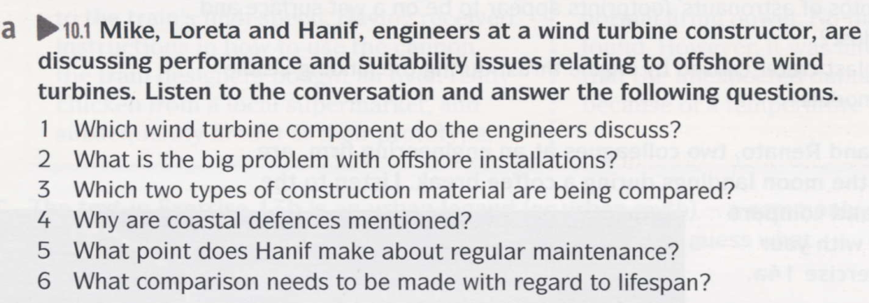


Slide 6
The tower
Corrosion due to the presence of saltwater
Steel and reinforced concrete
Because in reinforced-concrete coastal defenses, the steel reinforcement is often exposed, due to erosion, and rusts as a result
That just because an installation requires regular maintenance, that doesn’t necessarily mean it’s unreliable
A comparison of the difference between the construction cost of a reinforced concrete tower and the cost of repainting a steel tower over the period of a concrete tower’s lifespan

Slide 7
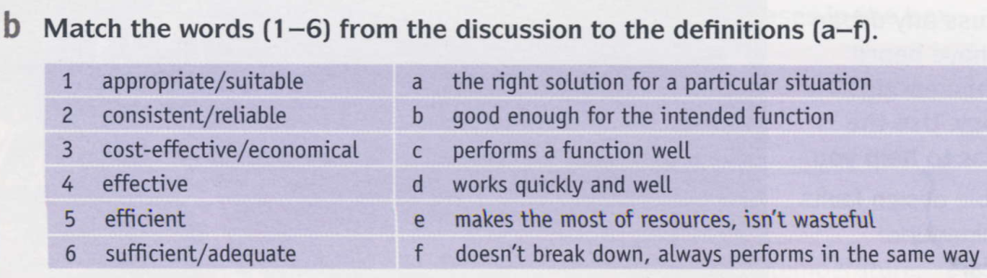
Notes:
1 b 2 e 3 c 4 a 5 f 6 d

Slide 8
b
e
c
a
f
d
Notes:
1 b 2 e 3 c 4 a 5 f 6 d

Slide 9
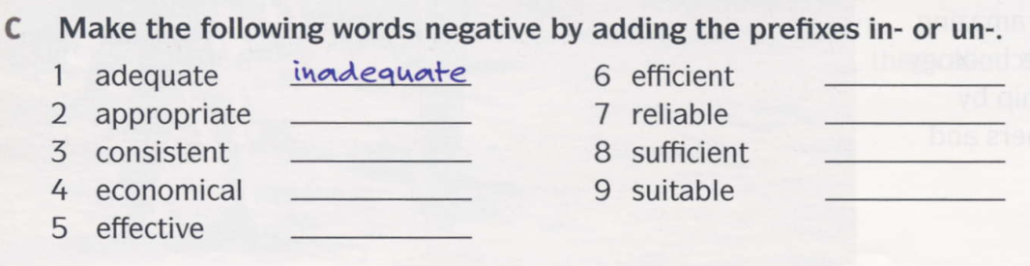
Notes:
2 inappropriate
3 inconsistent
4 uneconomical
5 ineffective
6 inefficient 7 unreliable 8 insufficient 9 unsuitable

Slide 10
inefficient
inappropriate
unreliable
inconsistent
insufficient
uneconomical
unsuitable
ineffective
Notes:
2 inappropriate
3 inconsistent
4 uneconomical
5 ineffective
6 inefficient 7 unreliable 8 insufficient 9 unsuitable

Slide 11
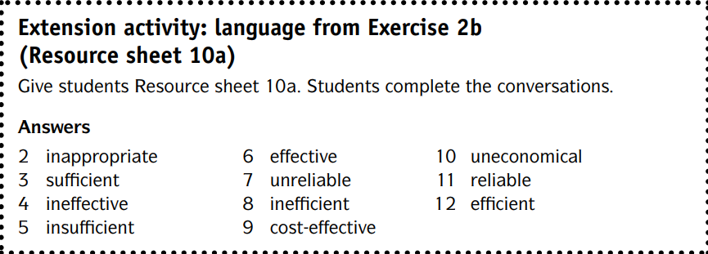

Slide 12
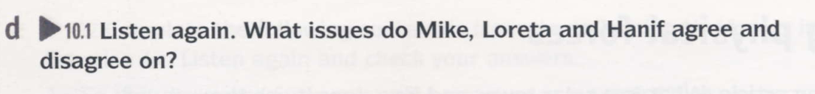


Slide 13
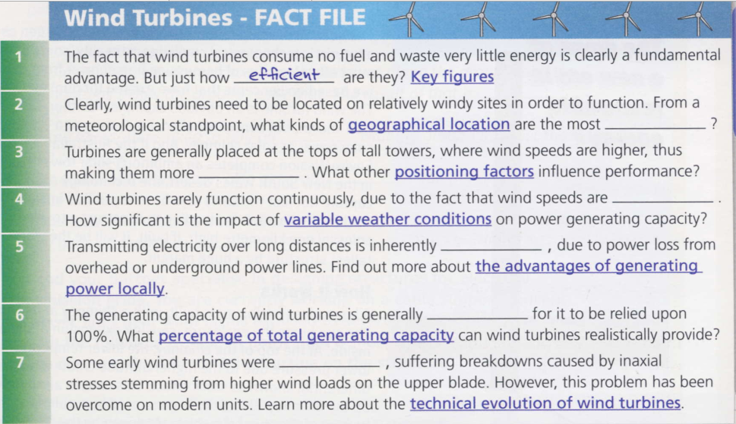

Slide 14
